Slide 1
Let’s Takeoff!

Slide 2
Paper Airplanes and Cost Accounting
Team roles
Six-person teams have one warehouse supervisor, one accountant, and four folders
Five-person teams have one warehouse supervisor, one accountant, and three folders
Four-person teams have one warehouse supervisor/accountant and three folders
Accounting Data (your accountant will build out the P&L on the whiteboard)
$10 sales price per plane
$1 cost per sheet of paper (direct materials cost)
$10 cost per employee per production period
$100 in overhead costs per production period
Production process is sequential
Each folder completes part of the plane and then hands it down the line to the next folder
The last folder also performs quality assurance (it has to fly in order to be “sold”)
So you need to quickly figure out how you're going to fold your planes and what your handoff steps will be in the folding process!
CRITICAL RULE – When I say “Stop,” you must immediately freeze all work on that second!

Slide 3
Just in Case You Don’t Know How

Slide 4
Get Ready for “Controlled Chaos!”

Slide 5
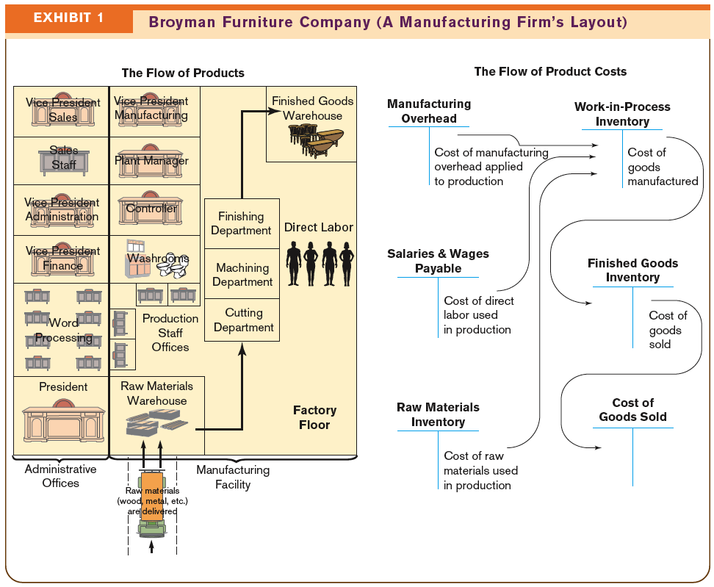

Slide 6
What are your “Click Notes” for Today?

